Slide 1
Power Laws Break Things:
Performance Projection Errors Induced by Ignoring Power Law Behavior in an M/G/1 Queue
Kenneth W. Comer
Associate Professor
Systems Engineering Operations Research
Volgenau School of Engineering
Computational Social Sciences
College of Science
George Mason University

Slide 2
Agenda
Power law distributions probably common
  Proving PL is difficult
What if we ignore PL?
  Bad things happen
How to detect PL (or PL-like) behavior?
How to simulate PL behavior?
How to parameterize a PL simulation?
When will we habitually ask: “Have you checked for PL behavior?”

Slide 3
The Power Law Distribution
Observed qualitatively (many, many small, a few large, rare extreme)
  Extreme values are so extreme as to “swamp the mean”
Often ignored in statistics
  Some have suggested that it does not exist
  Violates Kolmogorov’s principles (undefined variance and sometimes mean)
  ML techniques are particularly vulnerable to PL situations

Slide 4
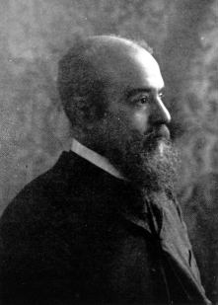
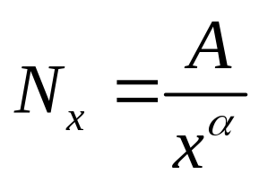
The Pareto Curve
Vilfredo Pareto was possibly the first
“data scientist”
  Set economics on a path away from descriptive,
  non-mathematical narrative of Adam Smith and
  Karl Marx toward an analysis of data
  His primary observations *1892) were on the
  distribution of income, first in Paris and later
  worldwide
  The Pareto Distribution refers to his equation, stated in
  terms of N_{x} the number of individuals with income
  greater than a value of x.
  Pareto’s equation:
  Now known as the CCDF
  With a particular value of α = 1.167, income will be distributed so that 80% of the income will be held by 20% of the individuals – Pareto’s 80/20 rule

Slide 5
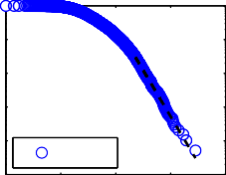
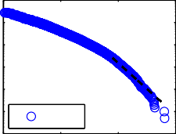
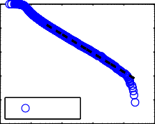
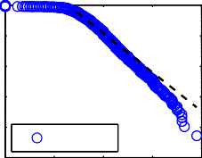
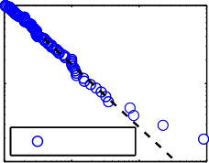
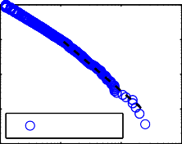
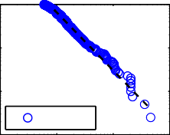
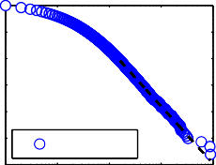
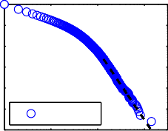
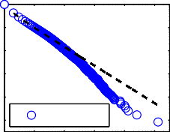
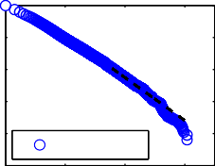
“Ubiquitous”
Clauset, Shalizi, Newman, 2009, extensive analysis of proposed PL distributions in:
Frequency of unique words Moby Dick
Protein degree distribution in a yeast.
Degree distribution of metabolites in E. coli.
The degree distribution of Internet autonomous systems
Number of calls received by AT&T
Intensity of wars from 1816–1980
Severity of terrorist attacks worldwide from 1968 - 2006
Bytes of data received in response to HTTP requests from computers at a large research laboratory
Species per genus of mammals during the late Quaternary period
Frequency of sightings of bird species in the United States.
Customers affected by electrical blackouts in the United States.
Sales volume of bestselling books in the United States.
Power-law distributions in empirical data
25
10⁰
₁₀−1
₁₀−2
−3
(m)
10⁰
10
₁₀−2
−3
10⁰
(n) ₁₀−1
−2
(o)
−1
10
₁₀−3
₁₀−4
₁₀−5
P(x)
10
10
−4
₁₀−4
−5
cities
email
−6
fires
10
0 2
4
6
8
10
0
3
10
4
6
10 10 10 10 10
10
10¹ 10² 10
10⁰ 10² 10
10
10⁰
₁₀−1
₁₀−2
₁₀−3
₁₀−4
−5
(p)
10⁰
₁₀−1
₁₀−2
₁₀−3
₁₀−4
−5
(q)
10⁰
(r)
P(x)
₁₀−1
10
flares
10 10 10 10 10 10
10
quakes
10
−2
religions
1 2
3
4
5
6
0
6
8
8
9
10 10² 10⁴ 10 10
10⁶ 10⁷ 10
10
10⁰
10
₁₀−2
−3
10⁰
₁₀−1
−2
₁₀ 10
surnames wealth
₁₀−4 ₁₀−3
10⁴ 10⁵ 10⁶ 10⁷ 10⁸ 10⁹
10⁰ 10⁰
₁₀⁻¹ (v) ₁₀−1
₁₀−2 ₁₀₋₂
−3
₁₀−3
−4
10⁰
(t) ₁₀−1
₁₀−2
₁₀−3
₁₀−4
¹⁰⁻⁵ citations
₁₀−6
10⁰ 10¹ 10² 10³ 10⁴
10⁰
₁₀−2
−4
−1
(s)
(u)
P(x)
₁₀10
₁₀11
(w)
(x)
P(x)
10
₁₀−4
−5
10
10
₁₀−8
web links
₁₀−10
10⁰ 10² 10⁴ 10⁶
x
10
₁₀−5
−6
¹⁰ authors ₁₀−6
10⁰ 10¹ 10² 10³
x
web hits
10⁰ 10¹ 10² 10³ 10⁴ 10⁵
x

Slide 6


Normalistan vs. Extremistan: The Stadium Paradox
100,000 individuals: height
  Mean height is 5’ 7” (170 cm)
  Worlds tallest is 8’ 3” (251 cm)
  If Sultan Kosan joins the crowd, its mean height changes by about 0.001 cm
100,000 individuals: wealth
  Mean wealth approx. $200,000
  Richest is Bill Gates at $72 billion
  If Bill Gates decides to attend the
  game, the mean wealth changes to
  $920,000 (a 460% increase)

Slide 7
Assume You’re Designing a Queue
Single-server, no capacity, exponential arrival times
Baseline: exponential service times
Parameterize the queue using a sample of 500 customers (“one day”)
What happens if you’re wrong about the service time distribution?
  What if it’s PL and not exponential?
  How often will the deployed systems “fail”
  What’s your likelihood of being fired?

Slide 8
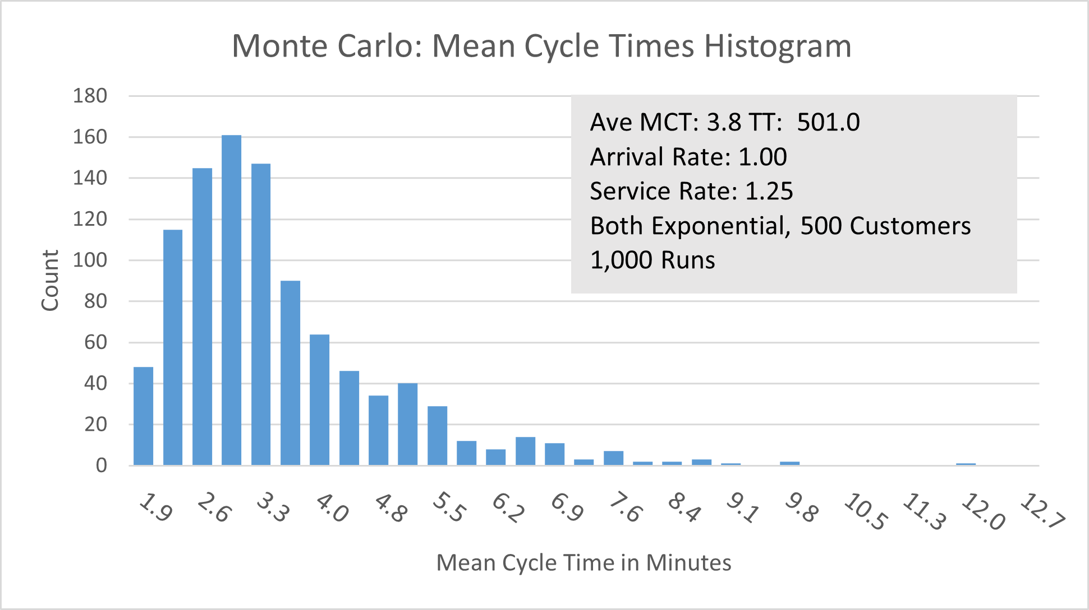
A Textbook Baseline M/M/1 Queue

Slide 9
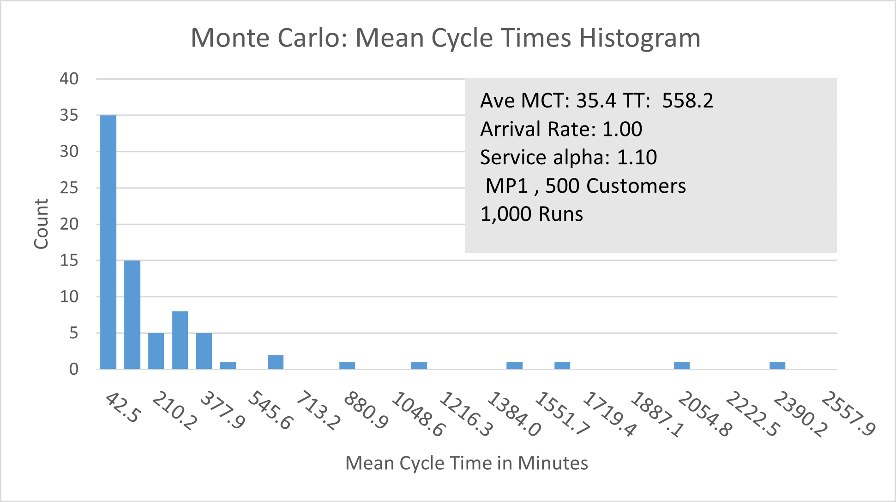
What Happens with M/P/1?

Slide 10
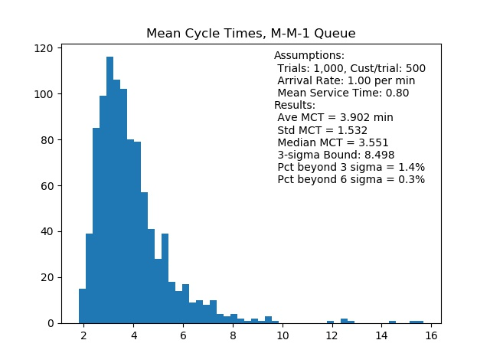
Simulation in Python

Slide 11
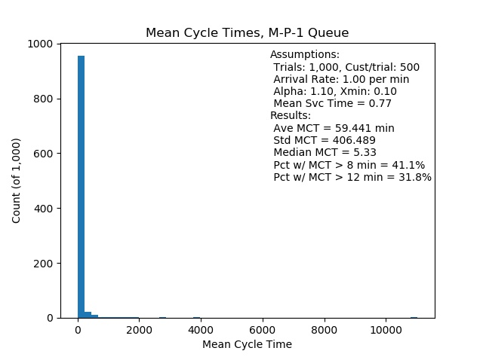
The M/P/1 Queue (Linear Scale)

Slide 12
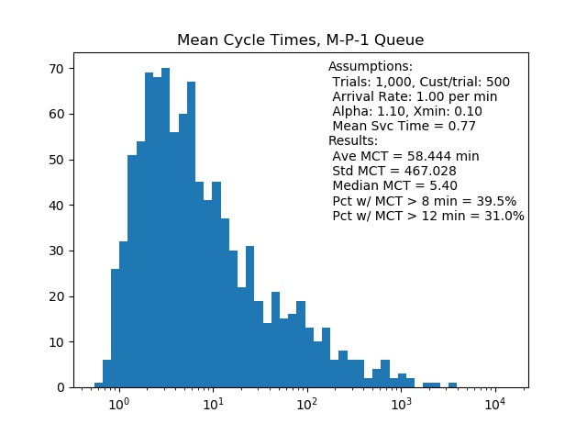
The M/P/1 Queue (Log Scale)

Slide 13
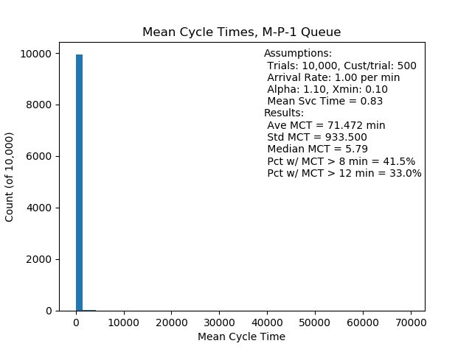
10K Trials M/P/1 Queue (Linear Scale)

Slide 14
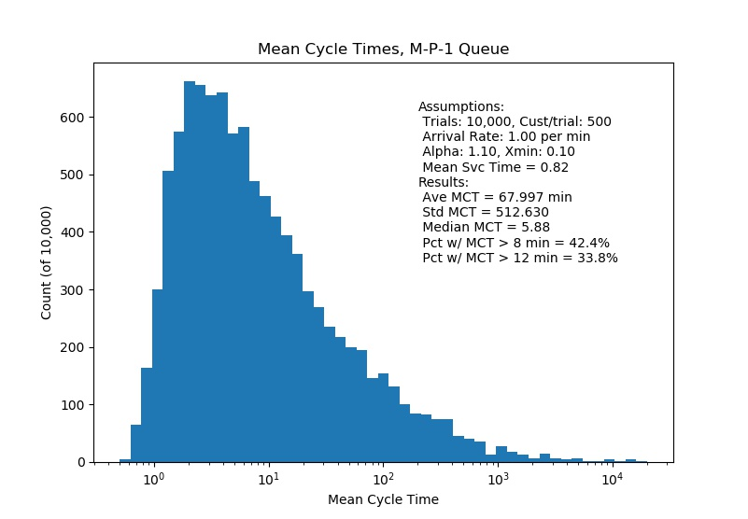
10K Trials M/P/1 Queue (Log Scale)

Slide 15
Conclusion: Do Your Homework!
Assuming you have a “well-defined” distribution when you actually have a power law will lead to spectacular failures on deployment
  If failure is > 3σ, 41% vice 1.4%
  If failure is > 6σ, 32% vice 0.3%
Due diligence should include investigating the potential for “mean swamping” behavior
  How do we detect power law behavior?
  How do we simulate PL behavior?
  How do we parameterize a PL random variable?

Slide 16
Detecting PL Behavior
Five informal techniques
  Q-Q plot
  Log-log plot
  Alstott’s CSV powerlaw Python application
  Lorenz plot (Gini coefficient)
  Sigma-convergence experiment
Nothing will prove the presence of PL over other, better-behaved distributions
  But the “alternative” is a very unusual distribution
  If you wish to simulate, the PL is probably the most stable of the PRNGs you would implement

Slide 17
Parameterizing PL RNGs
Two-parameter distribution: x_{min}, 
Note that x_{min} must not be zero!
PL is a continuous random variable, but real life often deals in discrete values (firm size, words, degree distribution, etc.)
  Some subjectivity involved in converting
Beware of the two definitions of PL distribution…

Slide 18
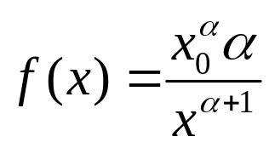

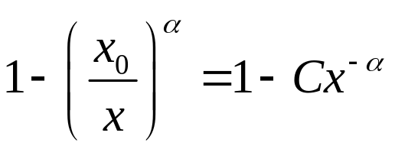
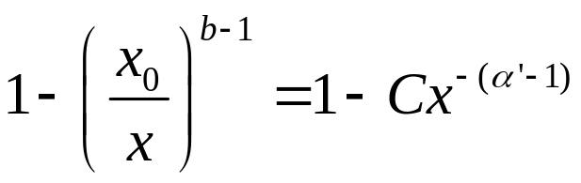

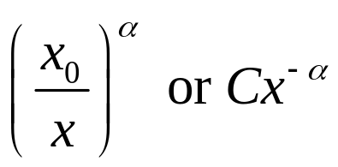
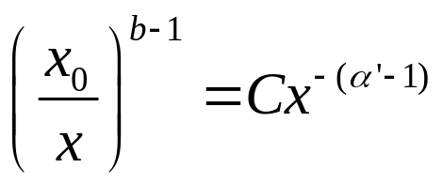

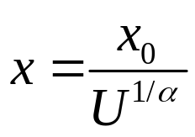
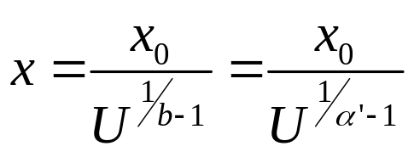
Dueling Power Law Distributions
Function | CDF-Defined PL | PDF-Defined PL
Used by: | Axtell, Pareto | Cioffi, Clauset et.al., Wikipedia
Power Law Exponent | α | α'
Probability Density Function
Cumulative Distribution Function
CCDF: =
Generating function for PL variates from U(0, 1)

Slide 19
Estimating 
Not effective: Linear regression of the log-transformed CCDF
Better: Work backwards from N and x_{max}
Best: Maximum Likelihood Estimator (the “Hill Estimator”)

Slide 20
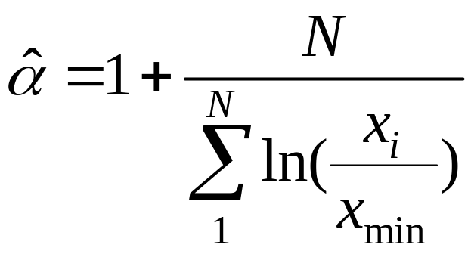
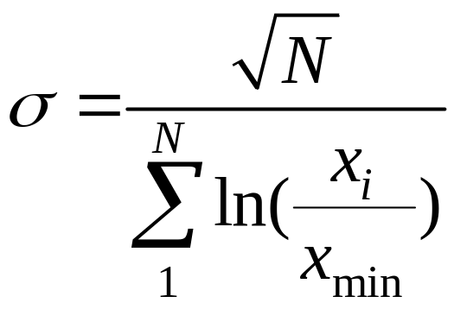

The MLE Calculation
The maximum likelihood estimator of a univariate data set is calculated on the entire set of observations, x_{i} , for i = 1 to N. (note this is for the PDF-defined alpha)
The Standard Error of the estimate is given by

Slide 21
Take-aways
In existing, “self-organized” systems you should always check for mean-swamping behavior
  A few outliers in your sample may be your only cue
  In system elicitation, consider questions like, “Are 80% of your resources consumed by the top 20% of your cases?”
Modern techniques exist to discover PL, to parameterize it, and simulate it
  Very few statistical packages envision PL
  ML seems particularly blind
PL appears in the presence of adaptation, so it may emerge even where it is not present historically
  Consider “circuit breakers” to interrupt operations when outliers are encountered

Slide 22
The Bigger Picture
Trendy consultants would have it that data, alone, can guide strategy
  Many suggest success depends on becoming a “data-driven” organization
  “Let the data be your model” is a common mantra
The alternative is systems analysis
  Seeking to understand the underlying, interacting systems that comprise the strategic situation
  A common thread for OR throughout its history
PL analysis is just another component of systems analysis – understanding the processes that create the patterns that big data can discover
OR analysts should realize that SA is their unique product – unavailable from automation or many overmarketed “analytic tools”

